Slide 1
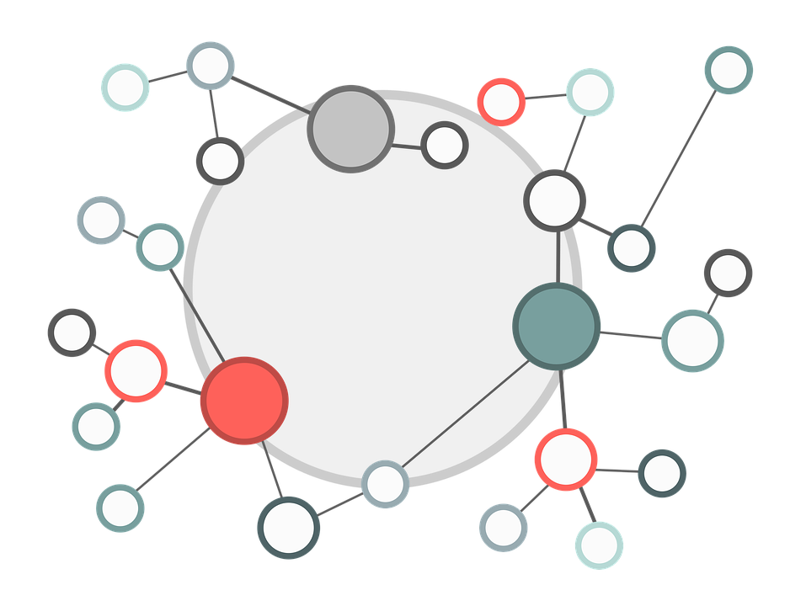
Blockchain P2P network
Blockchain technologies, lecture 5
Notes:
NOTĂ:
Pentru a modifica imaginea de pe acest diapozitiv, selectați-o și ștergeți-o. Apoi faceți clic pe pictograma Imagini din substituent pentru a insera propria imagine.

Slide 2
Course overview
Block propagation
Topology
Discovery protocol
Broadcasting, messages
Kademlia a peer to peer information system, RLPx
Wire protocol

Slide 3
BITCOIN TOPOLOGY

Slide 4
Bitcoin topology
Nodes in the network form a random graph.
Newly joined nodes query DNS servers.
DNS servers return a random set of bootstrap nodes.
A node learns about other nodes by listening from advertisements of new addresses coming from their neighbors.
Each node keeps list of opened connections. Node randomly selects an address from a set of known addresses and attempts to establish a connection.
Default number of connections: 8. Node’s number of connections may exceed the default number due to incoming connections.

Slide 5
Bitcoin topology
Each node tries to connect to peers using TCP (outbound connections).
Default number of outbound connections: 8.
A node stores IP addresses in two lists: new and tried.
new list. Addresses of peers to which the node has not yet tried to connect.
tried list. Addresses known as reachable
A nodes accepts inbound connections from other peers.

Slide 6
Bitcoin topology
A nodes accepts inbound connections from other peers.
A listening node (a node that accepts inbound connections) may issue
ADDR messages to advertise neighbors that it accepts inbound connections
neighbors may relay ADDR message to their own neighbors by following
a gossip protocol.
A node may request to discover other active peers by sending a
GETADDR message.
A nodes periodically verifies the state of the nodes it is connected to by issuing a
PING messages and waiting for PONG responses.

Slide 7
Bitcoin topology
Full nodes download every block and every transaction and verifies all consensus rules.
Miners nodes extending the blockchain by creating new blocks.
Miners may work alone or in mining pool with an administrator running a full node.
Lightweight nodes download only block headers and relies on full nodes.
Full nodes serve lightweight clients by notifying them when a transaction affects their wallet and transmitting transactions to the network.
DNS seeder server that responds to DNS query by initiating a message that contains a list of IPS. Six DNS seeds periodically crawl the network to obtain active IP addresses
DNS seeders are queried by new nodes
DNS seeders are queried by a node that restarts and tries to reconnect to new peers.

Slide 8
Bitcoin topology
DNS seeder server that responds to DNS query by initiating a message that contains a list of IPS. Six DNS seeds periodically crawl the network to obtain active IP addresses
DNS seeders are queried by new nodes
DNS seeders are queried by a node that restarts and tries to reconnect to new peers.
DNS servers are hard-coded as trusted DNS servers maintained by the core developers.
SPAM score. Each node scores peers, higher scores are assigned if a peer act as malicious node. Node stops sending messages to a peer that accumulated 100 points, for a period of 24h.

Slide 9
Bitcoin network messages

Slide 10
Updating and synchronization
There are two types of transactions that update the distributed ledger replicas:
tx messages and block messages.
tx and block messages are advertised with inv messages.
inv message contains a set of transaction hashes and block headers received by the sender.
getdata message is issued by the receiver of a inv message to the sender for a transaction or o block
The propagation delay is the sum of transmission time and the local verification time of the block or transaction.

Slide 11
INV
A
B
getdata
TX

Slide 12
GOSSIP PROTOCOLS

Slide 13
Gossip protocols
Each node sends a message to K random targets (multicast).
K -- infection factor.
Flooding: If a node gossips to all neighbors.
Each target randomly select another K targets.
Process stops when all nodes receive the message or when the message expires.

Slide 14
4
2
6
1
7
3
12
14
5
8
11
10
13
9

Slide 15
4
2
6
1
7
3
12
14
5
8
11
10
13
9

Slide 16
4
2
6
1
7
3
12
14
5
8
11
10
13
9

Slide 17
4
2
6
1
7
3
12
14
5
8
11
10
13
9

Slide 18
4
2
6
1
7
3
12
14
5
8
11
10
13
9

Slide 19
Gossip protocols
Reliability: broadcast to entire network.
A node send a small number of messages.
Fault-tolerant
Small number of rounds to reach the entire network.
A super node could keep track of every message.
A super node may deanonymize Bitcoin transactions.

Slide 20
Gossip protocols -- diffusion
Each node sends a message to K random targets (multicast).
Each peer waits a random delay (exponential) before sending the message.

Slide 21
4
2
6
1
7
3
12
14
5
8
11
10
13
9

Slide 22
4
2
6
1
0.4s
7
3
12
0.6s
14
5
8
11
10
13
9

Slide 23
4
0.1s
2
6
1
7
0.2s
3
12
0.2s
14
5
8
11
10
13
9

Slide 24
4
2
6
1
0.4s
0.5s
7
0.1s
3
12
0.1s
14
5
8
11
10
13
9

Slide 25
4
2
6
1
0.3s
0.4s
7
3
12
14
5
8
11
10
13
9

Slide 26
KADEMLIA-RLPx EThereum

Slide 27
Kademlia-RLPx
Peer-to-peer <key, value> storage. DHT - distributed hash table.
Lookup system.
Routing algorithm based on routing tables
Locates servers near a destination key.
Minimizes number of messages nodes must send to each other (configuration messages).
Uses parallel asynchronous queries.
Yields a topology of low diameter.
RLPx, Ethereum node discovery protocol is based on Kademlia.

Slide 28
Kademlia-RLPx
Each node has an id, in Ethereum ENODEID, secp256 hash.
Each node store a node record, in Ethereum ENR.
Distance between nodes is given by XOR metric.
distance(n1,n2) = keccak256(n₁) XOR keccak256(n₂)
XOR symmetric distance: nodes receives queries from nodes contained in their routing tables.
Routing information are learned from received queries.
Every message includes sender’s node ID, permitting the recipient to record sender’s ID if necessary.

Slide 29
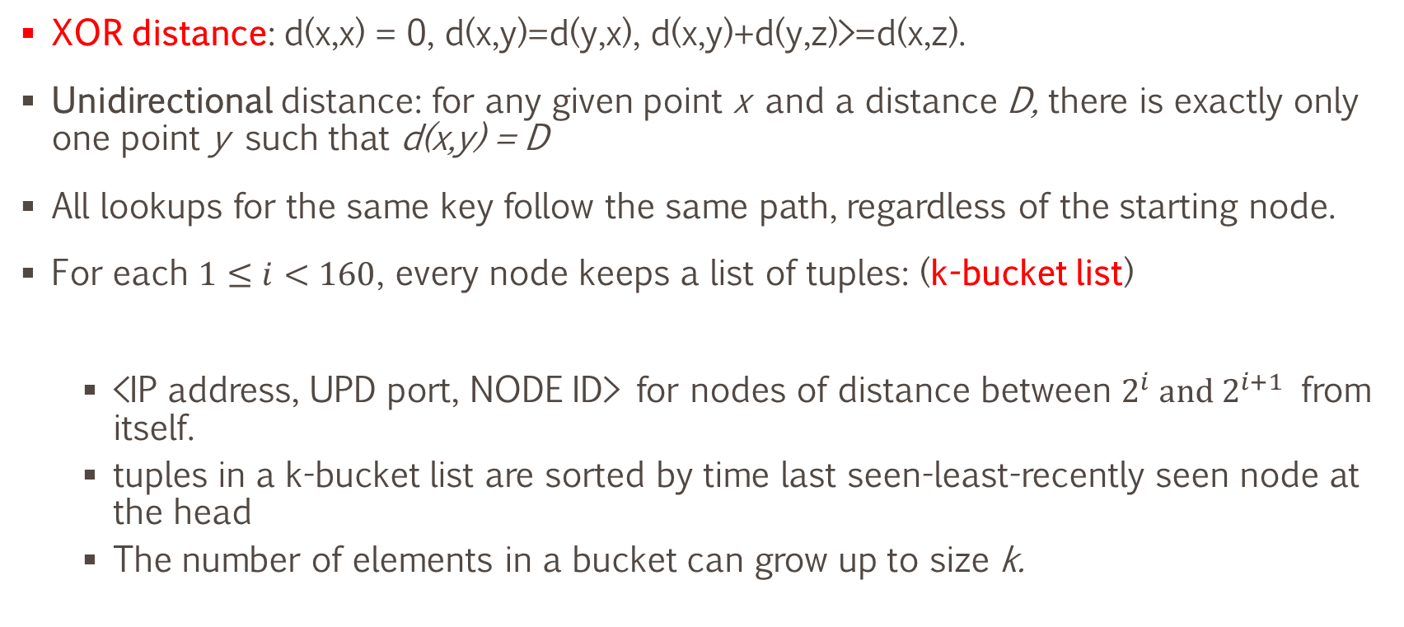
Kademlia-RLPx
XOR distance: d(x,x) = 0, d(x,y)=d(y,x), d(x,y)+d(y,z)>=d(x,z).
Unidirectional distance: for any given point x and a distance D, there is exactly only one point y such that d(x,y) = D
All lookups for the same key follow the same path, regardless of the starting node.
For each $1≤i<160$, every node keeps a list of tuples: (k-bucket list)
<IP address, UPD port, NODE ID> for nodes of distance between $2^{i} and 2^{i+1}$ from itself.
tuples in a k-bucket list are sorted by time last seen-least-recently seen node at the head
The number of elements in a bucket can grow up to size k.

Slide 30
Kademlia-RLPx
Live nodes are never removed from the k-bucket list.
When a node receives a request or a replay from a node it updates the k-bucket list.
If the sender already exists in the recipient list, the recipient moves it at the tail of the list.
If the node is not already in the appropriate k-bucket and the bucket has fewer than k entries, then the recipient inserts the new sender at the tail of the list.
If the node is not already in the appropriate k-bucket and the bucket is full, then the recipient pings the s the k-bucket’s least-recently seen node (head).
If the least-recently seen node doesn’t respond, it is evicted from the k-bucket and the new sender inserted at the tail.
if the least-recently seen node responds, it is moved to the tail of the list, and the new sender’s contact is discarded.

Slide 31
Kademlia-RLPx
k-buckets maximize the probability that the nodes they contain will remain online, the longer a node has been up, the more likely it is to remain up another hour.
Node failures are inversely related to uptime.
DoS attacks resistance.
RPCs:
PING check if a node is online.
STORE <key, value> request a node to store a <key, value> pair.

Slide 32
Kademlia-RLPx
FIND-NODE finds 160-bit ID. It returns a k triples of type:
<IP address, UDP port, Node Id> for the k-nearest nodes the recipient knows about closest to requested ID.
k triples are gathered from one or more buckets.
FIND-VALUE
if the recipient previously received a STORE <key, value> request it returns the value it stored.
If the recipient didn’t receive a STORE<key, value> request it returns a list of k triples:
<IP address, UDP port, Node Id> for the k-nearest nodes the recipient knows about closest to requested key.

Slide 33
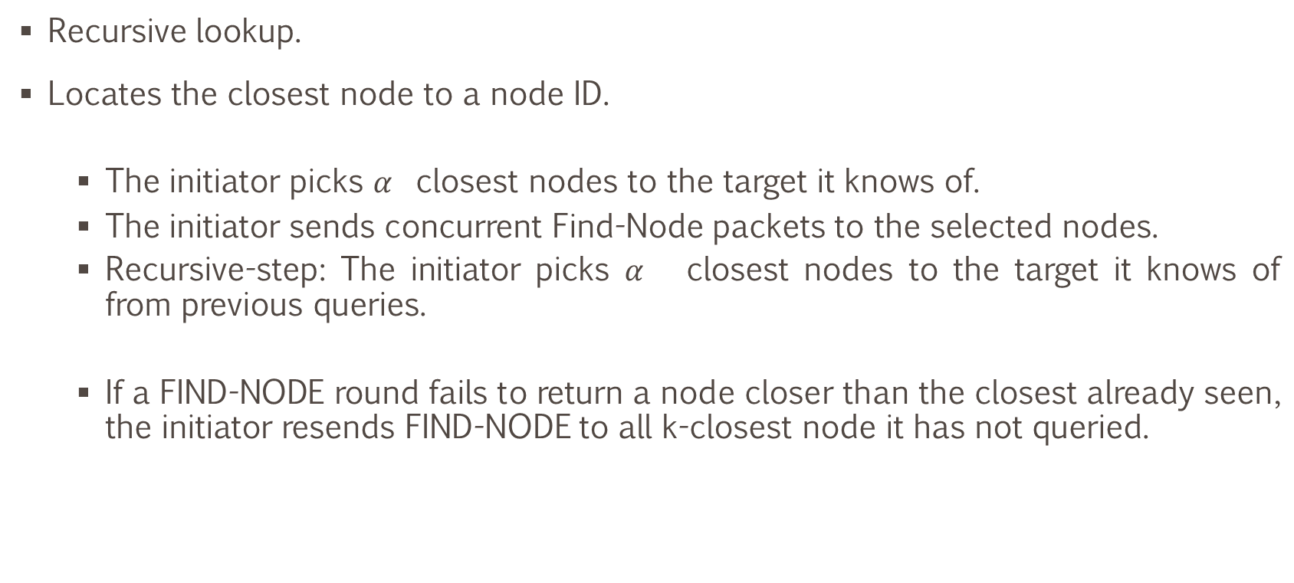
Kademlia-RLPx
Recursive lookup.
Locates the closest node to a node ID.
The initiator picks $α$ closest nodes to the target it knows of.
The initiator sends concurrent Find-Node packets to the selected nodes.
Recursive-step: The initiator picks 𝛼 closest nodes to the target it knows of from previous queries.
If a FIND-NODE round fails to return a node closer than the closest already seen, the initiator resends FIND-NODE to all k-closest node it has not queried.

Slide 34
Kademlia-RLPx
Extension of RLP serialization format.
Does not use STORE and FIND_VALUE.
Keys are randomly defined. Geographic information cannot be inferred from distance.
Nodes generate a ECDSA key-pair, with 512-public key as ENODEID.
The distance between two nodes N1, N2 is the length of the common prefix of N1 and N2.

Slide 35
Wire protocol

Slide 36
Wire protocol-Ethereum
Application layer protocol for propagating transactions and block.
Facilitates exchange of Ethereum blockchain information between peers over TCP
To establish a connection STATUS messages are sent. Recipient is informed about:
version: the current protocol version.
networkid
td: total difficulty of the best chain
blockhash: hash of the block with the highest TD known
genesis: hash of the genesis block
forkid: fork identifier RLP([FORK_HASH, FORK_NEXT])

Slide 37
Wire protocol-Ethereum
Examples of validation rules for connections EIP-2124
Nodes must run on the same network
If two chains share the same genesis, but not forks (ETH / ETC), they should reject each other.
If the remote FORK_HASH is a subset of the local past forks and the remote FORK_NEXT matches with the locally following fork block number, connect.
Remote node is currently syncing. It might eventually diverge from, but at this current point in time we don’t have enough information
Following STATUS message reception, three operations can be performed:
Chain synchronization: New clients request blocks and sync to existing state.
Block propagation: newly mined blocks are relied to all nodes.
Transaction exchange: pending transactions are relied to miners.

Slide 38
Wire protocol-Ethereum
Chain synchronization: New clients request blocks and sync to existing state
STATUS message includes total difficulty TD and the hash of the best known block.
NODE with worst TD sends GetBlockHeaders
The response contain a number of block headers, beginning a a certain start_block, with most limit number of blocks.
After receiving BlockHeaders nodes verifies PoW and sends a GetBlockBodies message.
Received blocks are executed in the EVM.
Fast sync: synchronize transactions results (tree states and receipts)

Slide 39
Wire protocol-Ethereum
Block propagation: newly mined blocks are relied to all nodes
NewBlock announces the receiver of the existence of a new block.
Store that sender knows block hash.
Receiver verifies header of the block.
PoW
Gas limit
Difficulty’
Block time etc.
Receiver send the block to a small fraction of connected peers which it didn’t notify earlier.
Block is executed and state-root must match the post state-root.
Receiver sends NewBlockHashes message about the new block to all peers which which it didn’t notify earlier.

Slide 40
Wire protocol-Ethereum
The reception of a block announcement may also trigger chain synchronization.
Reduce block reputation for a block if block:
Announces hashes that later refuses to honor with Block messages.
Sends hashes or blocks already known to peers.
Sends transaction back to a peer that already know of it.
A node remembers transactions hashes it has relayed to connected peers.
A node remembers block hashes it has relayed to connected peers.

Slide 41
Wire protocol-Ethereum
Transaction exchange
Nodes store pending transactions in transaction pool
NewPooledTransactionHashes and GetPooledTransactions for transaction pool synchronization when a new connection is established.
New transactions are propagated using Transactions and NewPooledTransactionHashes.
Transaction messages are sent to a small fraction of connected peers.
NewPooledTransactionHashes is sent to all peers unnotified before.
All peers receiving a notification of the transaction hash can request the complete transaction object if it is unknown to them GetPooledTransactions.

Slide 42
Bibliography
Number of Bitcoin nodes: https://bitnodes.io/
Information Propagation in the Bitcoin Network Christian Decker,∗ Roger Wattenhofer https://tik-old.ee.ethz.ch/file/49318d3f56c1d525aabf7fda78b23fc0/p2p2013_041.pdf
Bitocin full nodes: https://bitcoin.org/en/full-node#what-is-a-full-node
https://en.bitcoin.it/wiki/Protocol_documentation
Kademlia: A Peer-to-peer Information System Based on the XOR Metric https://www.scs.stanford.edu/~dm/home/papers/kpos.pdf
Ethereum RLPx https://github.com/ethereum/devp2p/blob/master/discv4.md
Ethereum Wire Protocol https://github.com/ethereum/devp2p/blob/master/caps/eth.md

